Slide 1
NIIT Technologies
Digital 1000 – eShop.com

Slide 2
Project Overview
As a part of Digital 1000 initiative this project is a show case on implementation of the eshop.com project …
Latest Products Catalog
T-Shirts
Shirts
Trousers
Jeans
Dresses
Shorts
Watches
Shoes
Products Specific Catalog
T-Shirts
Shirts
Trousers
Jeans
Dresses
Shorts
Watches
Shoes

Slide 3
Project Overview
Technologies Used:
Node.js
Angular.Js SPA
MongoDb
Bootstrap
HTML5
CSS3
Express.Js
Passport.Js
PUG
S/W Used:
Visual Studio Code
MongoDb Chef
Login Page
New Customers
Registered Customers
Account Registration Page
First Name, Last Name
Email
Password/Re-Enter Password
Mobile Number
Shopping Cart
My Shopping Bag
Add/Remove products
Place Orders
Members Area
View Profile
View Orders Details

Slide 4
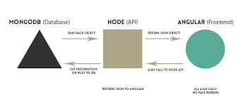
Architecture

Slide 5
Architecture
Web
HTML
CSS
HTML-5
ANGULAR -2
Rest API<EXPRESS > NODE JS Server
MONGO DB

Slide 6
Project Team
L
L
Vinay Kumar
Abhishek Kumar
Navneet Gupta

Slide 7
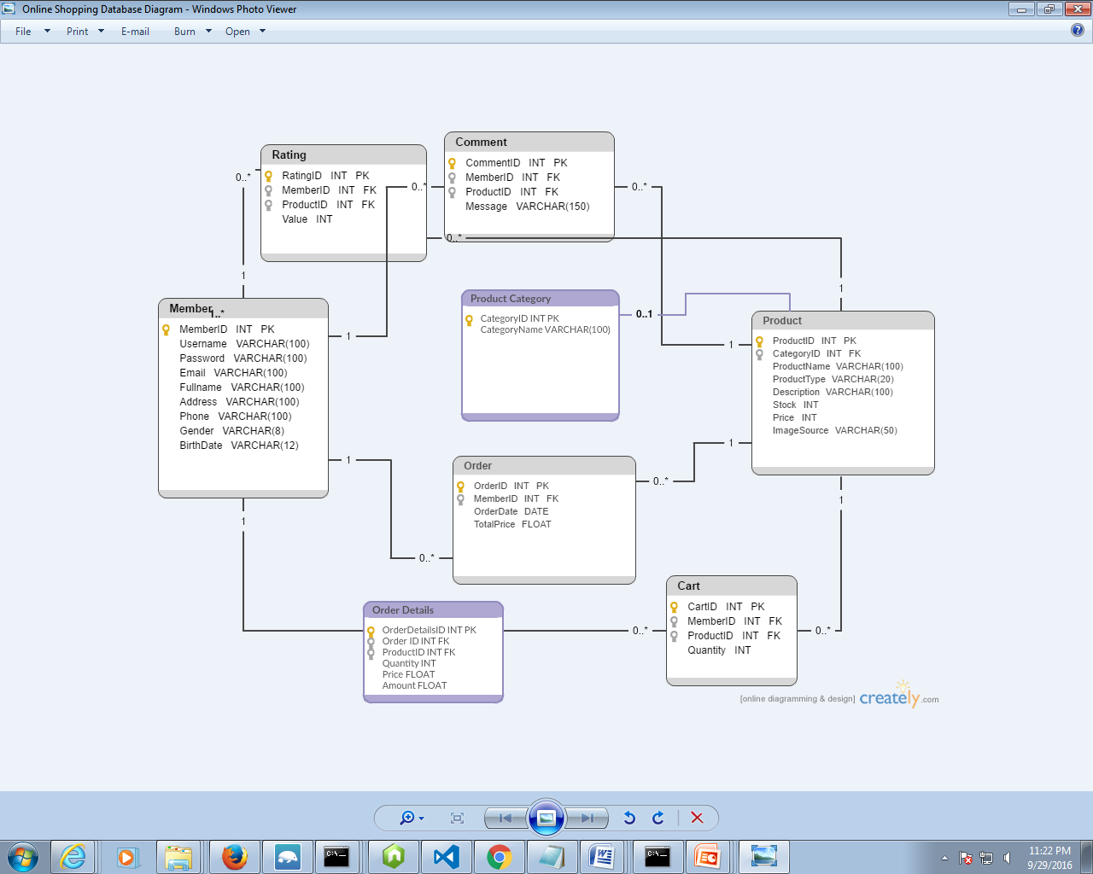
Database Diagram

Slide 8
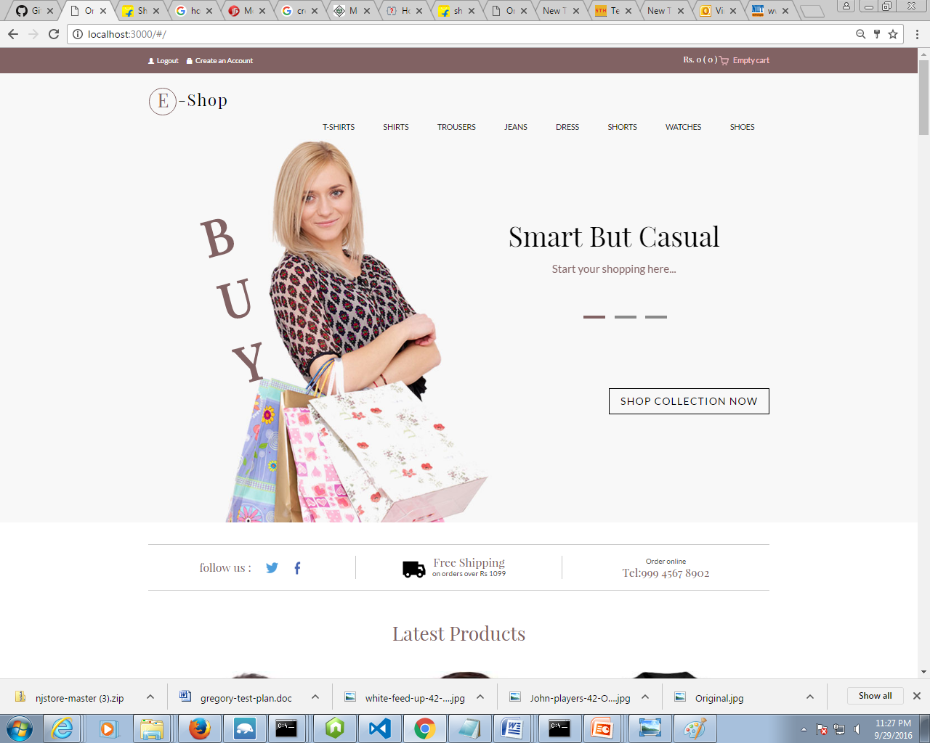
Home page: eshop.com

Slide 9
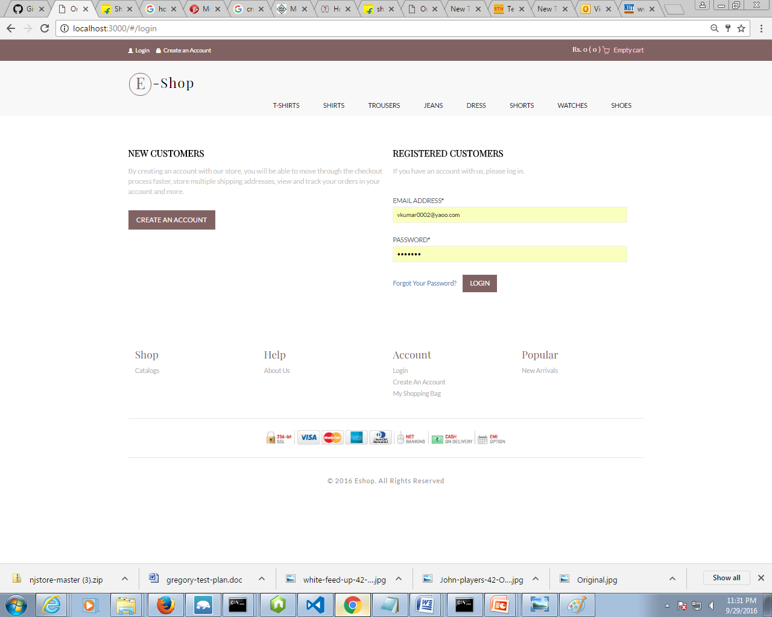
Login Page

Slide 10
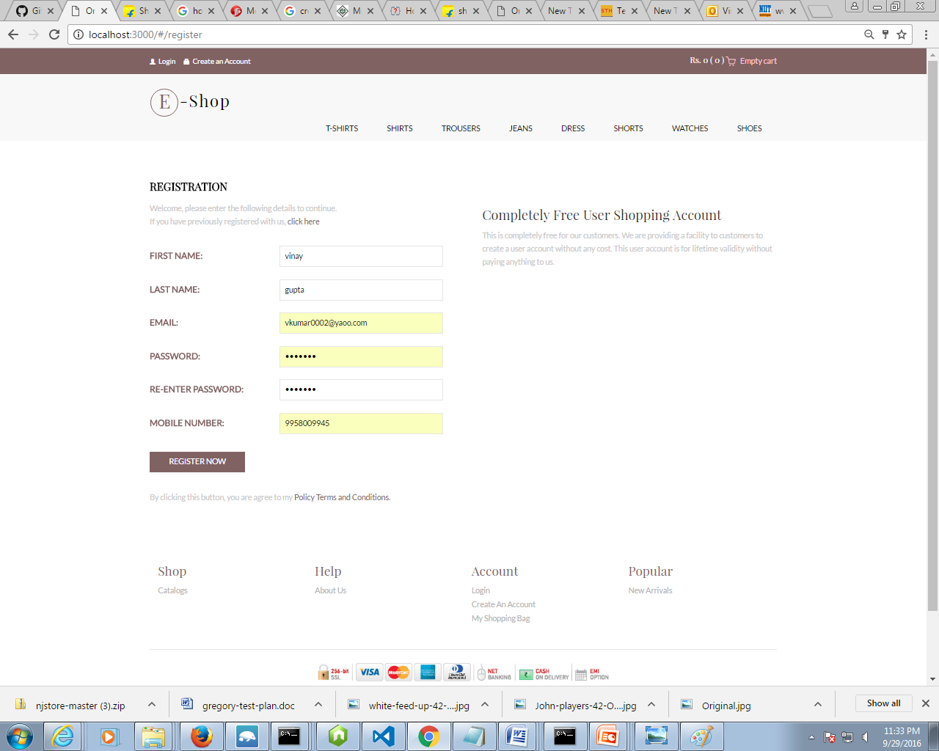
Customer Registraion Page

Slide 11
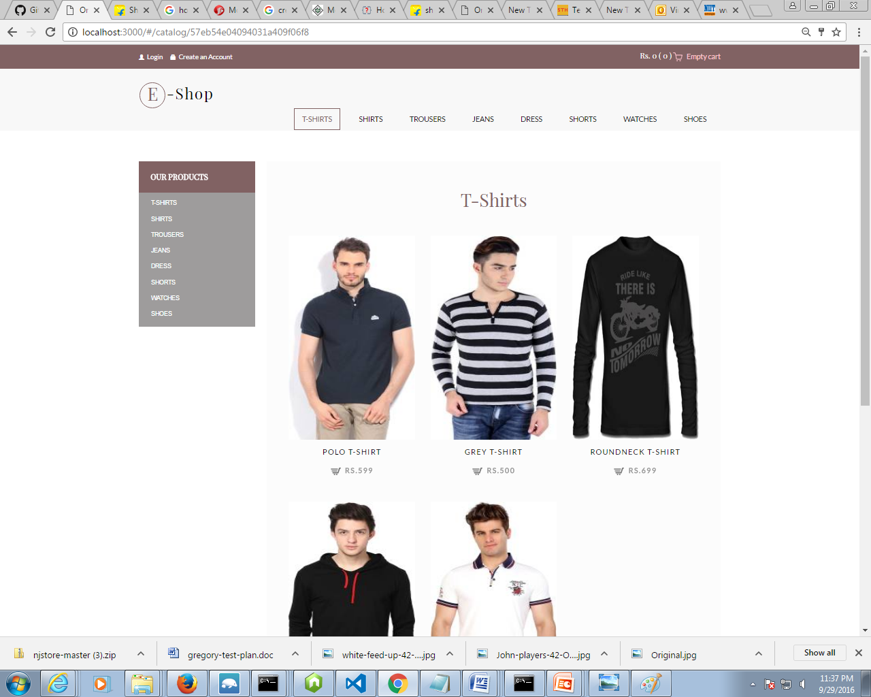
Products Specific Catalog :T-Shirts

Slide 12
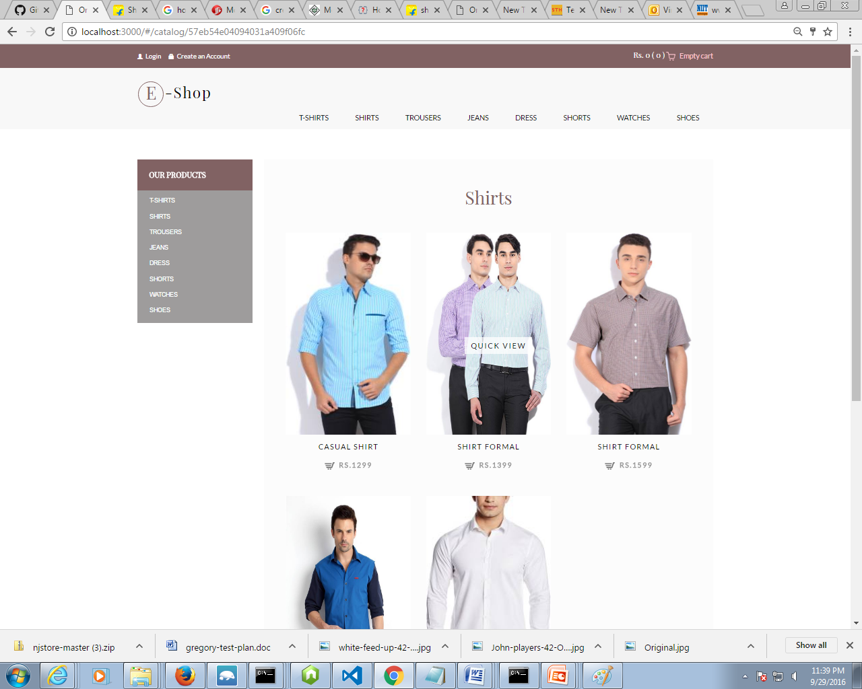
Product Specific Catalog :Shirts

Slide 13
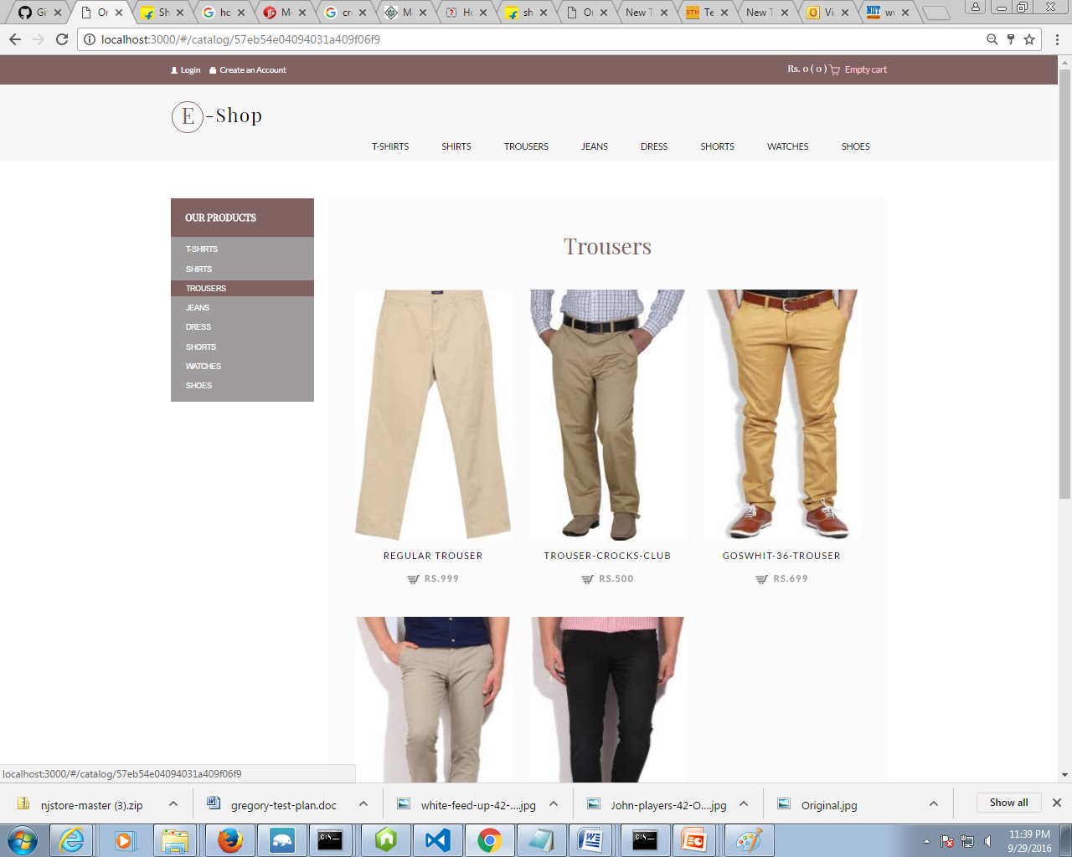
Product Specific Catalog : Trousers

Slide 14
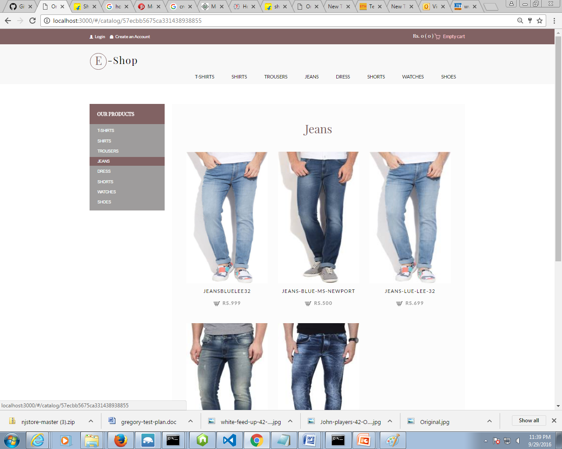
Product Specific Catalog : Jeans

Slide 15
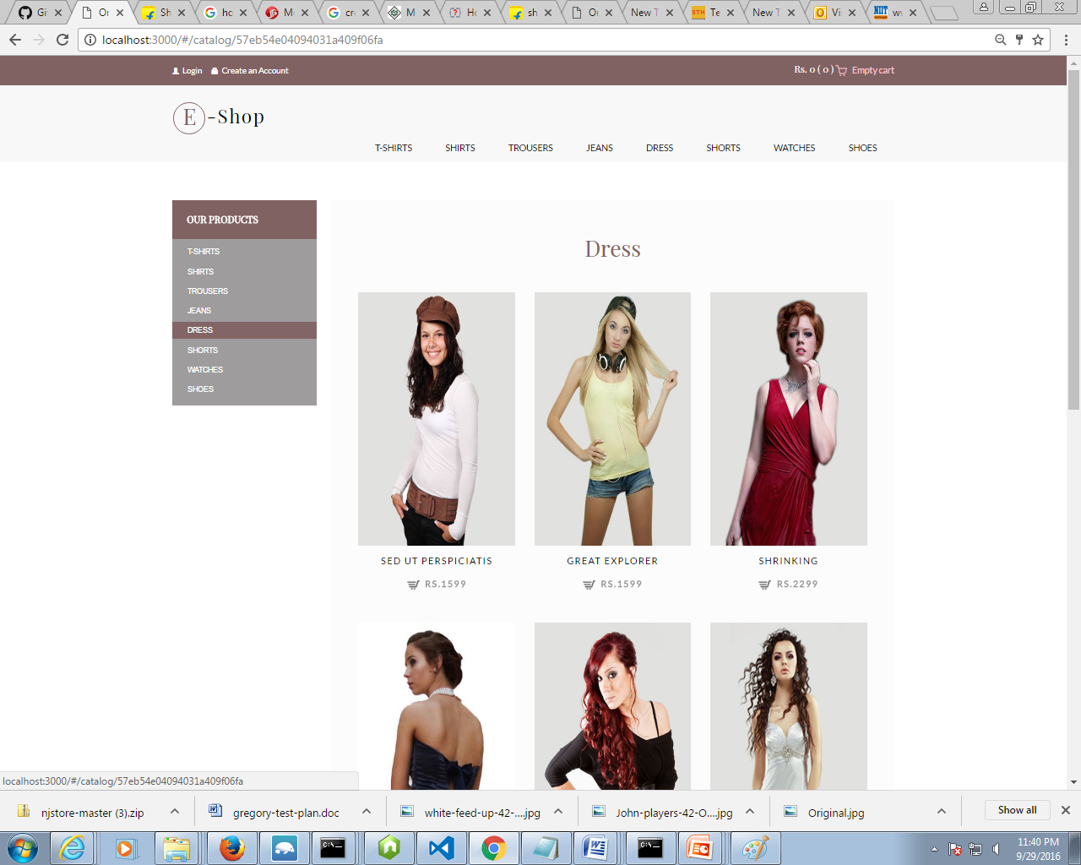
Product Specific Catalog : Dress

Slide 16
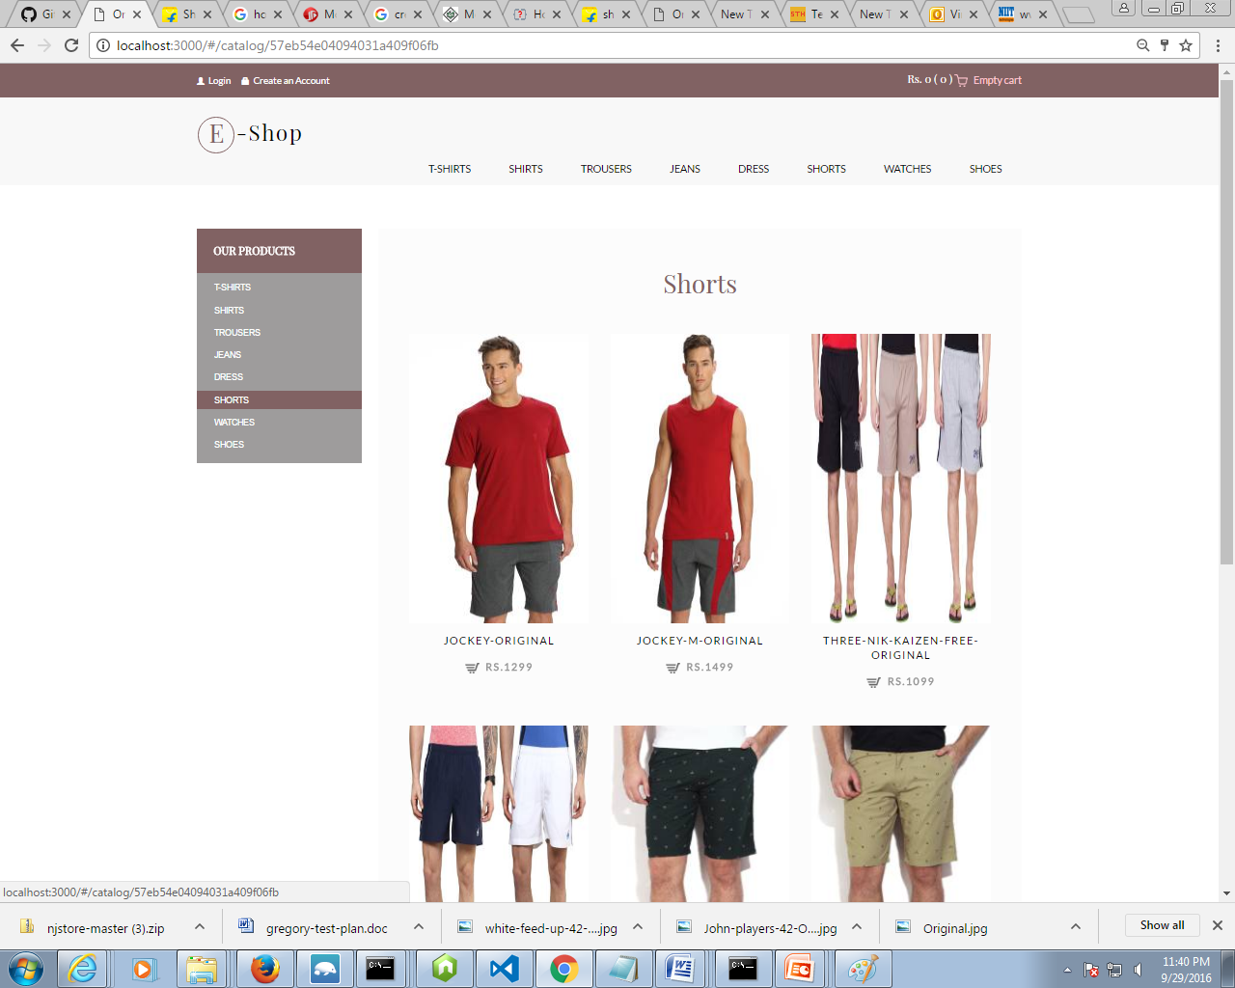
Product Specific Catalog : Shorts

Slide 17
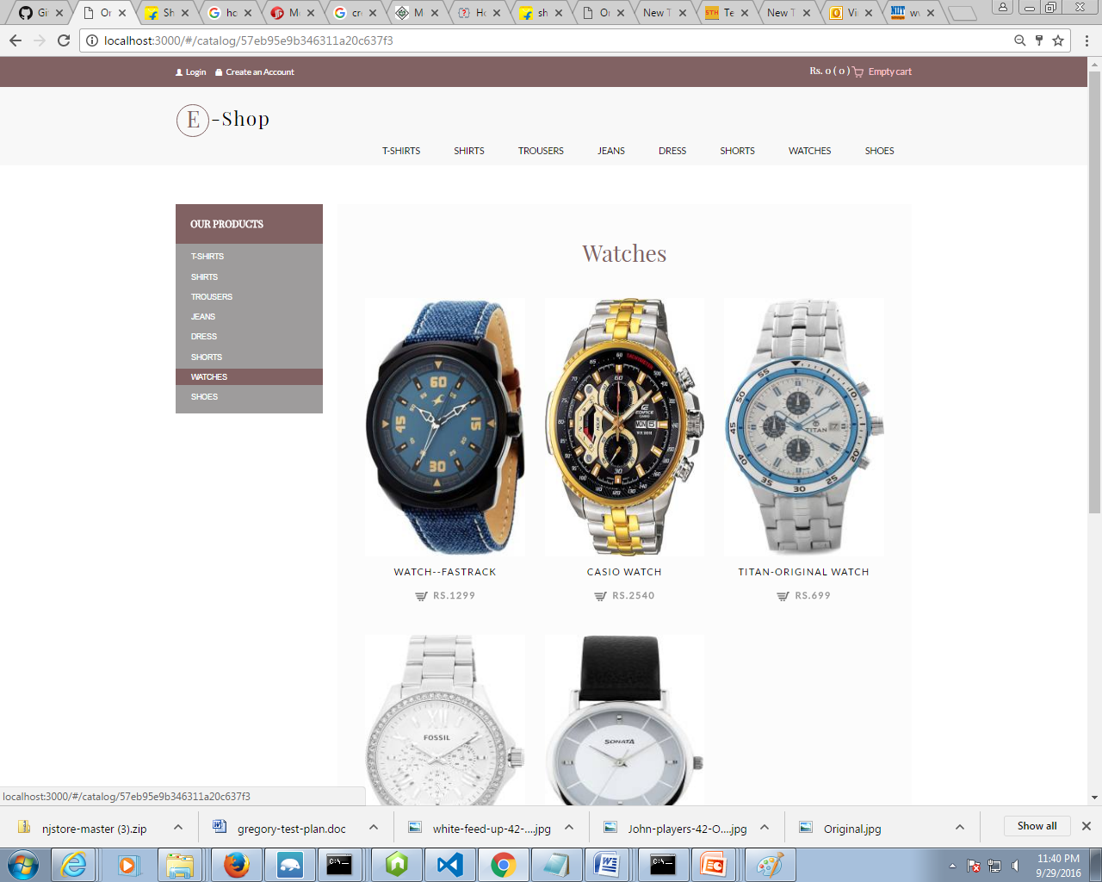
Product Specific Catalog : Watches

Slide 18
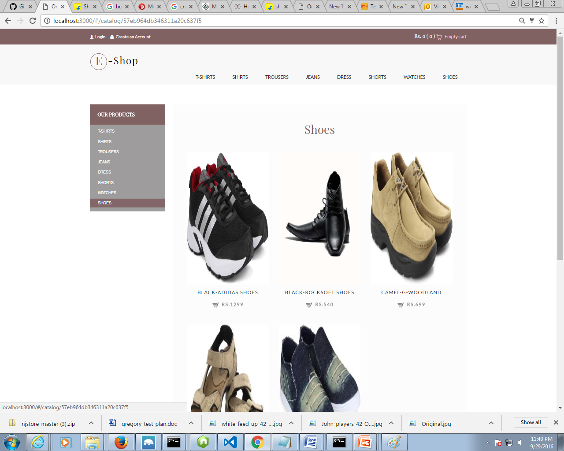
Product Specific Catalog : Shoes

Slide 19
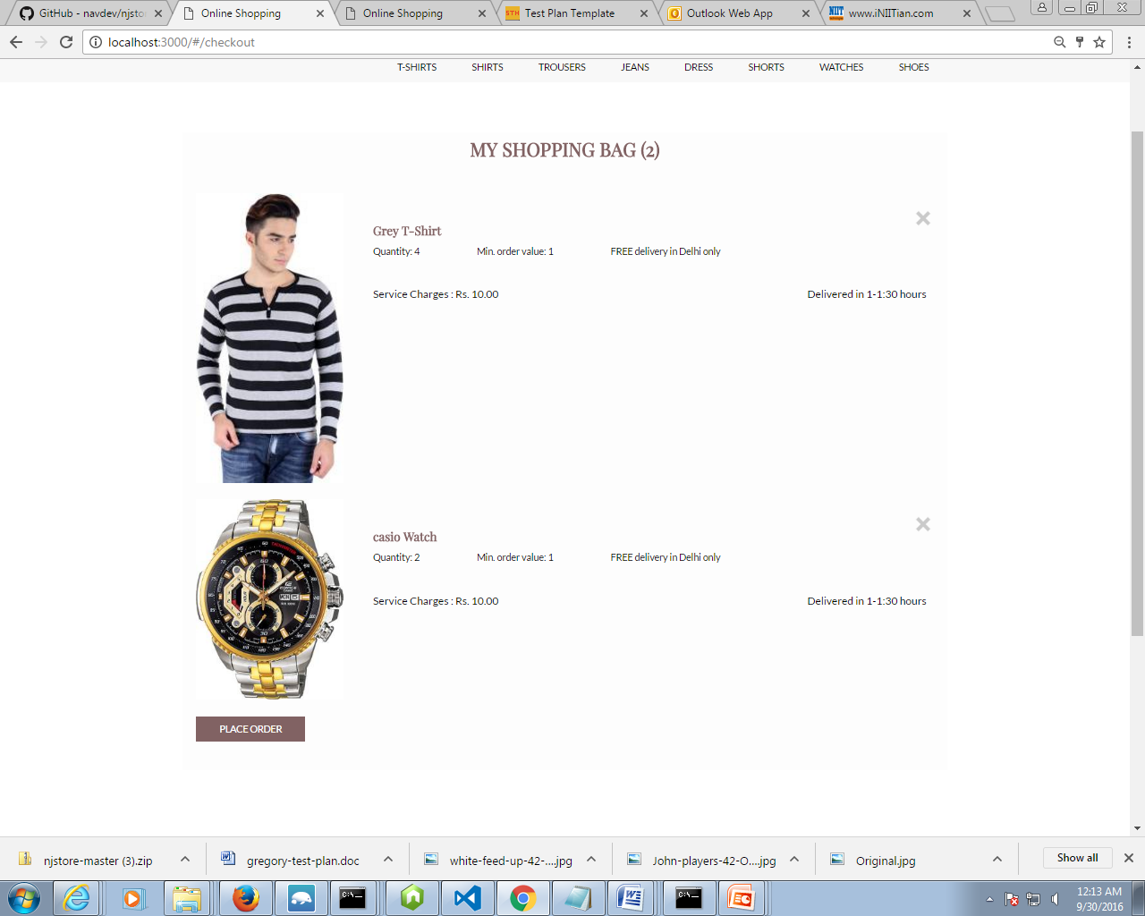
Shopping Cart: Page

Slide 20
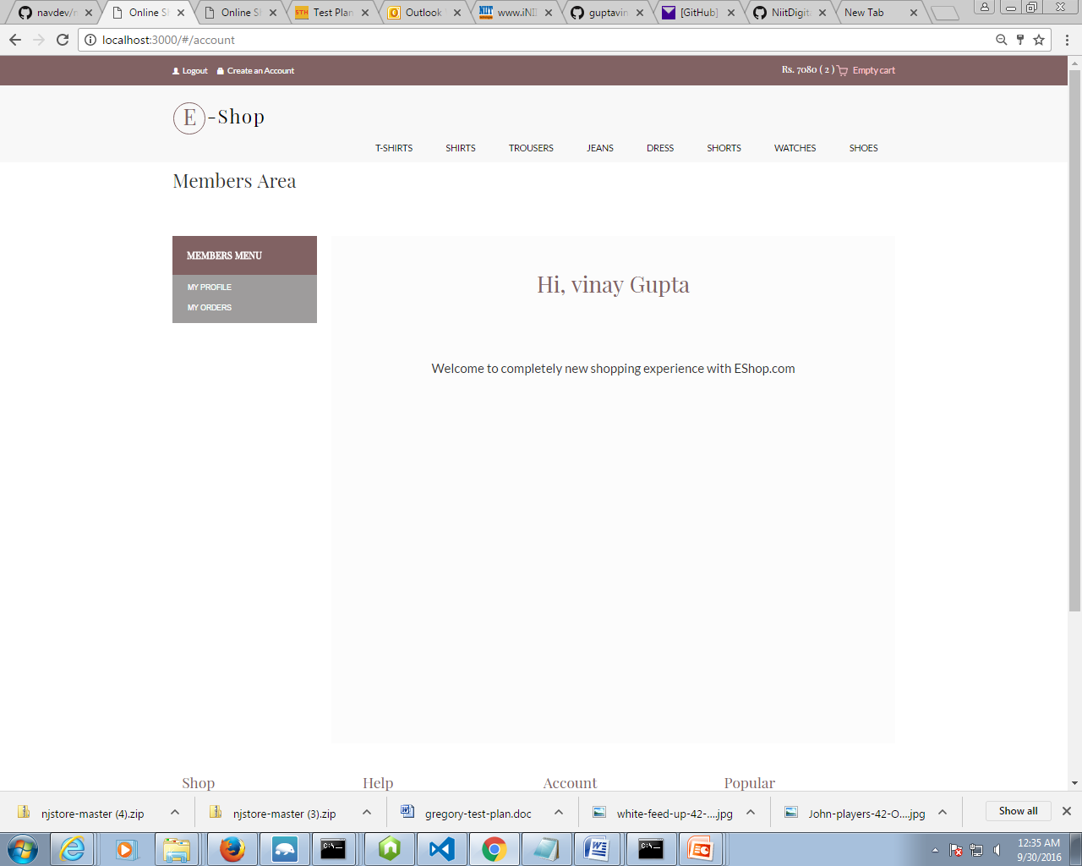
Members Area Landing Page

Slide 21
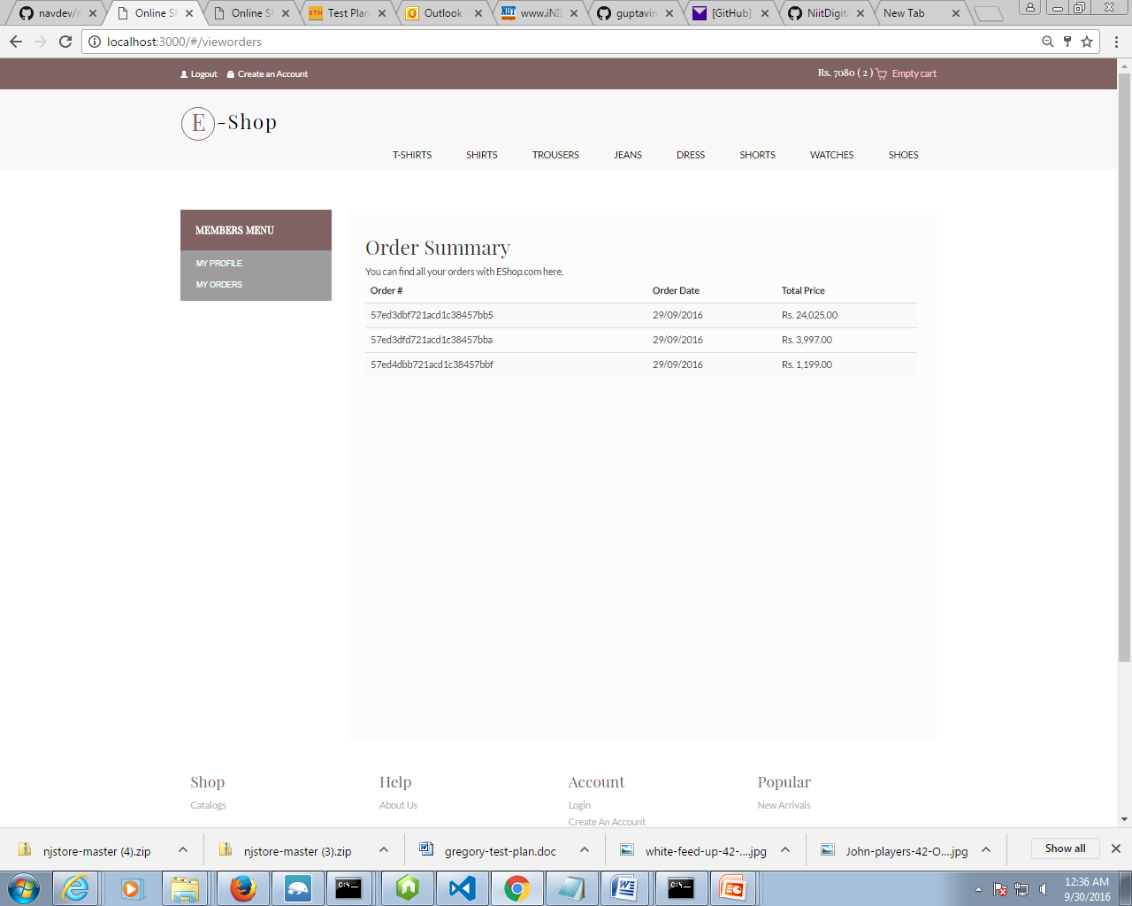
Order Summary Page

Slide 22
Thank You
Thanks to Digital 1000 team

